Slide 1

General Meeting
9/12/20
DIGITAL

Slide 2
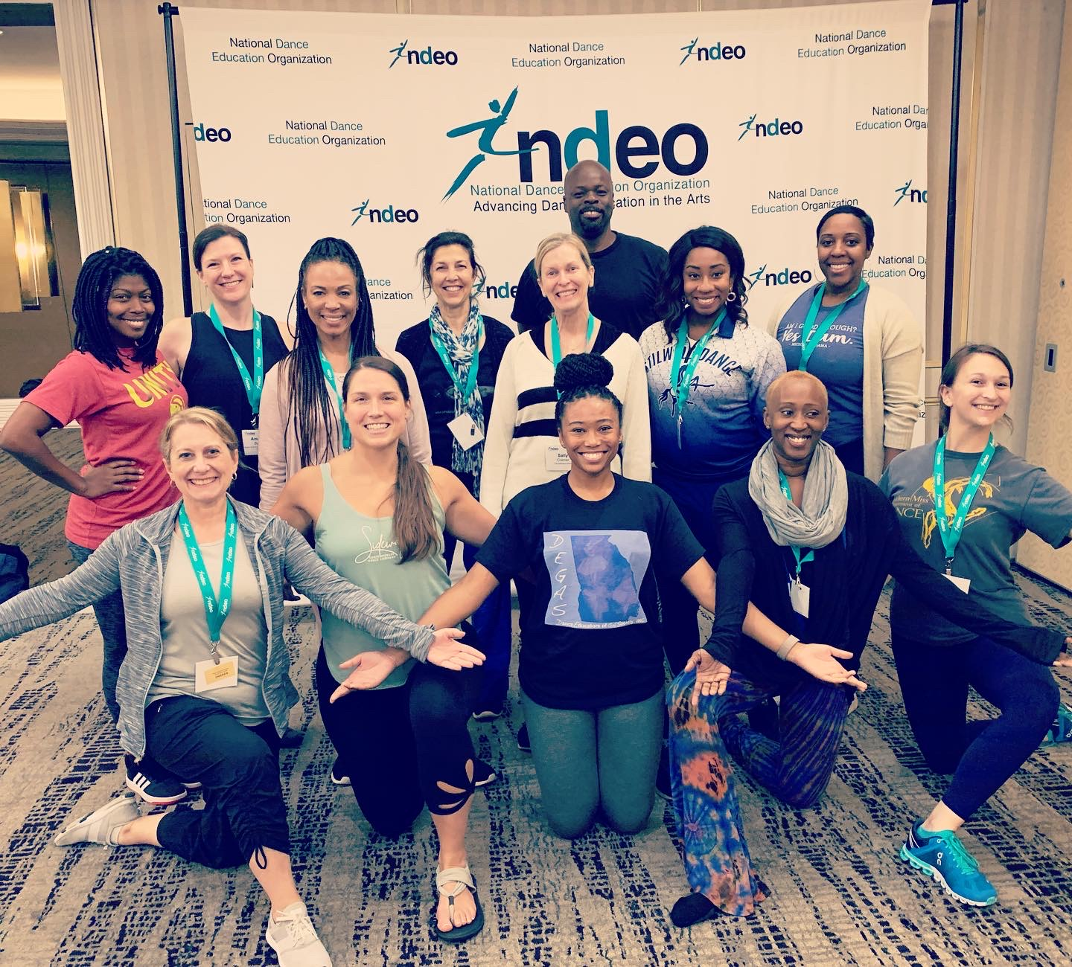
Welcome!
Molly Howel, DEGAS President

Slide 3
Board Members
Meet the DEGAS Board!
President- Molly Howel
Vice President- Eileen Edwards
Secretary- Tamara Irving
Treasurer- Mary McIntosh
Director of Communications- Patrice Yantawood
Director of K-12 Schools- Reyna O’Leary
Directors of Membership- Caroline Cates
Director of National Honors Society for Dance Artists- Tina Martin
Director of Community Engagement- Sally Cramer
Director of Professional Development- Ellen Tshudy
Director of Studios- Michelle Jericevich
Collegiate Director- Mary Claire Mixon
North GA Director- Courtney Bromwich
Southeast GA Director- Lauren Hawthorne
Southwest GA Director- Amy Taylor

Slide 4

What is DEGAS?
Mission Statement:
DEGAS is a non-profit Georgia affiliate of NDEO dedicated to advancing dance education and providing support for dance educators.
Vision:
Our vision is for every Georgia resident to have access to quality dance education opportunities.
Core Values:
Professional development and resources for K-12, studios, and universities
Promoting the art form of dance and lifelong learning for Georgia residents
Fostering a community of dance educators invested in the growth of Georgia dance
Cultivate opportunities for all Georgia residents to engage in dance experiences

Slide 5
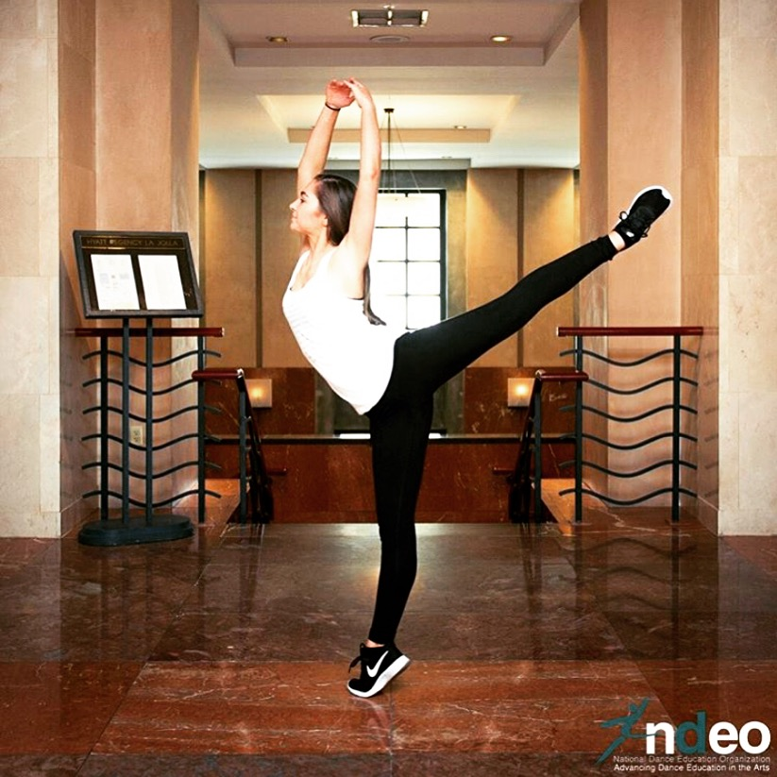
Fast Facts about DEGAS
-Dual Membership in both NDEO and DEGAS
-A portion of your NDEO membership dues come back to Georgia through DEGAS
    ($30 for professional and $40 for Institutional) -102 DEGAS/NDEO members in GA
-50 NHSDA Chapters in GA
- 2 Collegiate Chapters
- 39 Secondary Chapters
- 9 Junior Chapters

Slide 6

Year in Review
Attained Incorporation, Non-Profit, and State Affiliate Status
“The Benefits of DEGAS and NHSDA Info Session” at Gwinnett Dance Day (Cancelled due to COVID)
National Arts Advocacy Day
“NHSDA Lunch ‘n Learn” at the Woodruff Arts Center Educator’s Conference
“The Benefits of DEGAS and NHSDA Info Session” at the GA Department of Education’s Fine Arts Coordinator Workshops
NDEO Conference
‘Processing Emotions Through Choreography’ (Molly Howel)
KSU Dance Festival (Cancelled due to COVID)
Arts Day at the Capitol
Digital Dance Learning Labs

Slide 7
Upcoming Opportunities
Savannah En Pointe Festival (October 9-11, 2020)
Virtual NDEO Conference (October 18-20, 2020)
Arts Day at the Capitol (February 2021)
KSU Dance Festival (February 2021)
Gwinnett Dance Day (March 2021)
NHSDA Artistic Merit- GA Scholarship Award Winner
National Arts Advocacy (March 2021)

Slide 8
Fiscal Health Report
Current Account Balance: 4,571.82
Current budget expenditures: Website upkeep, business incorporation fees, swag
Goals for Fundraising: Continue to provide professional development and eventually host a PD conference. Grow local NHSDA chapters.
Revenue sources: NDEO dues- our share is currently cut in half
Donations
Please donate!
https://www.plumfund.com/charity-fundraising/DEGAS
Your donations help to support our PD initiatives for local teachers and programs!

Slide 9
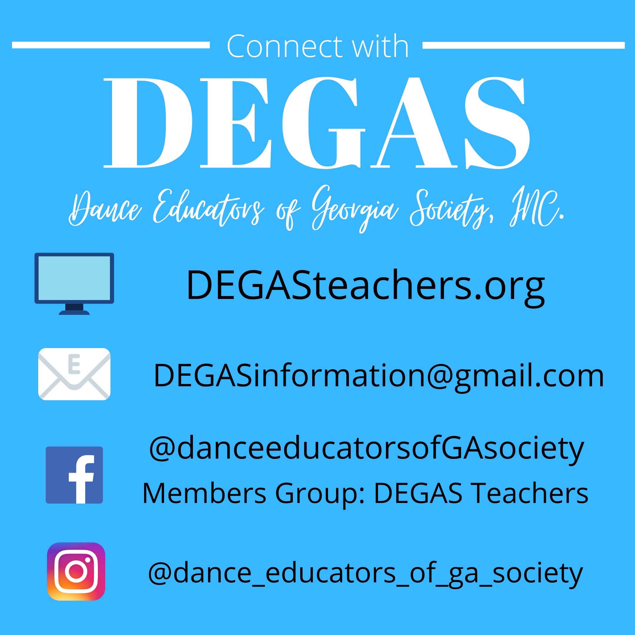
Committee Reports
Communications
NHSDA
Professional Development
New Committees!
Community Outreach
Digital Dance Resources
Notes:
https://forms.gle/nE45Ai8uAPwP6cc7A

Slide 10

NDEO Conference 2022 in Atlanta!
State Affiliate Expectations
Theme Brainstorming
Break Out Sessions:
  School Tours
  Pop-up Performances
  Pre-Conference Sessions

Slide 11
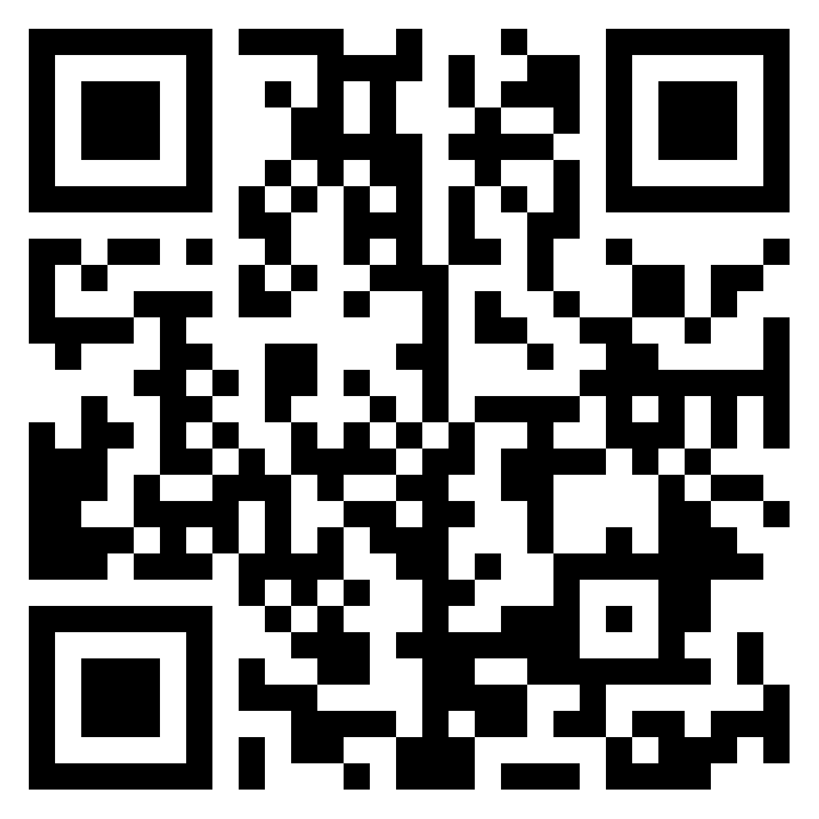

Slide 12
Wrap Up
Find us online!
  Facebook: @danceeducatorsofGAsociety
  Instagram: dance_educators_of_ga_society
  Website: degasteachers.org

